Slide 1
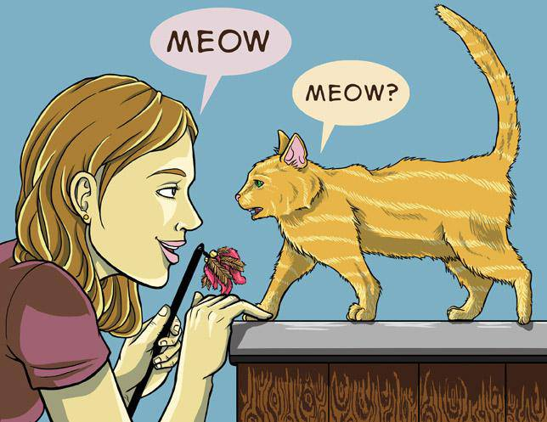
The Kitty Listener
Do you love cats ? Did you always dream to comunicate with those adorables furballs ?

Slide 2
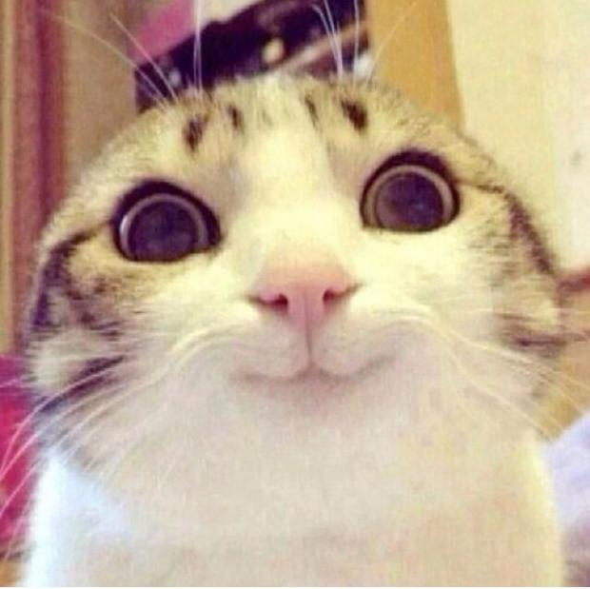
If your answer is YES !!!
Then the Kitty Listener is for you !

Slide 3
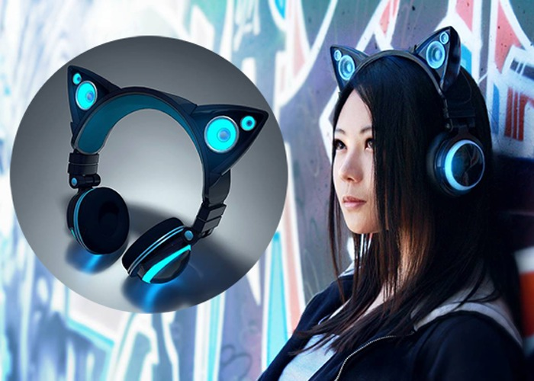
What it looks like

Slide 4

How it works ?
Thank to many dedicated scientists that have studied cat’s behavior, we have created an algorithm that is able to interpret the meowing of a cat and tell what the cat want to say.
This algorithm will be able to work thanks to a microphone included in our head-set and the information given will be interpreteted and then transmitted to the user thanks to earphones.

Slide 5
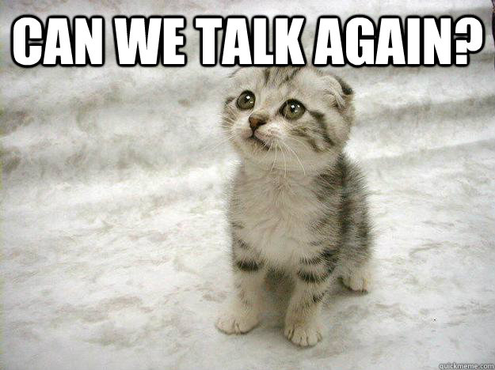
Why you need it
Understand your cat is the more important thing if you want to successfully take care of him, it will tell you when he want to sleep, eat, if he want to go outside, play and many other thing….

Slide 6

Commercialisation
To launch this beautiful tool we will need 500,000 € this will permit us to begin the production and export it everywere, we will sold it easily at 99 € by unit because everyone love cats and want to understand them, and so we think that this product will be a mass success.

Slide 7

How we use your money ?

Slide 8

Profits
A single Kitty Listener will cost us 30€ to product we will sell it at 99€
So on each sales we will make a bit more than 200% of benefits

Slide 9

Thanks for your attention !

